Slide 1
Predictive & Behavioral Telecom Churn Framework
To predict the behaviour of customer who are subscribe

Slide 2
STEPS :-
Data Collection:
Data Cleaning:
Data Analysis:
Model Building:
Model Testing :
Model Evaluation:

Slide 3
Dataset for the model:-
The dataset for the model was taken from the Kaggle.com website.
The dataset tell about the customer’s who has taken the subscription of a telecom company.
The predictive analytical modeling dataset is extracted directly from the standardized Kaggle repository, distributed in a raw comma-separated value (CSV) schema.
The set consist of 100 customer and their behavior .

Slide 4



Core Analytical Tech Stack
Pandas
NumPy
Matplotlib
Scikit-Learn
Enables structural ingestion of the CSV dataset, index mapping, schema alignment, and initial cleaning of categorical labels.
Provides fast array computing for processing mathematical transformations, vector calculations, and standard matrix modeling inputs.
Generates distribution visualizations, correlation metrics heatmaps, and diagnostic feature-importance plots for model interpretability.
Acts as the operational core for preprocessing scales, class-weight balancing, cross-validations, and model classification engines.

Slide 5
Data Preprocessing Workflow
Handling Nulls & Outliers Imputing sparse missing cells in the critical 'TotalCharges' Continuous Vector utilizing localized column median values to prevent data skew.
Categorical Vector Encoding Transforming binary text values (e.g., Partner, Dependents) to [0, 1] formats, and deploying One-Hot Encoding on multi-categorical features.
Standard Feature Scaling Applying Scikit-Learn's robust StandardScaler algorithms to continuous parameters ('tenure', 'MonthlyCharges') to resolve wide margin scaling errors.
Class Imbalance Correction Evaluating the skewed 26.5% baseline churn ratio. Rectifying variance bottlenecks via SMOTE oversampling to stabilize classifier margins.

Slide 6
The Dual-Model Framework
Deploying a paired software system

Slide 7
Model 1: Churn Predictive Engine
The primary predictive engine is engineered using advanced ensemble classifiers to achieve high recall on at-risk subscribers.
By using Scikit-Learn's Ensemble APIs, this model outputs a real-time probability score for every customer record.
The algorithm is tuned specifically to minimize False Negatives. This guarantees that customer accounts matching complex risk indicators are identified and surfaced before they reach final service termination.

Slide 8
[MP]Model 2: Diagnostics
Accuracy & Customer Behaviour Analyzer
While Model 1 calculates raw probabilities, Model 2 is designed specifically to analyze features and explain customer behavior.
By implementing decision-tree structures and feature weight maps, Model 2 extracts the underlying behavioral factors that lead to churn (such as contract expiration or internet type changes).
This diagnostic approach allows the business to see not only which customers are likely to leave, but why they are leaving.

Slide 9
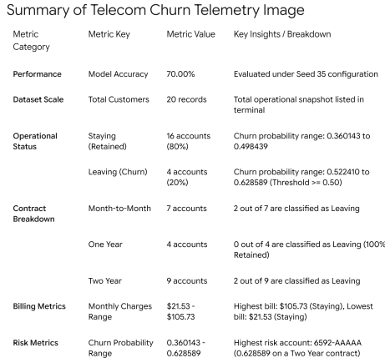
Dual-Model Evaluation Matrix

Slide 10
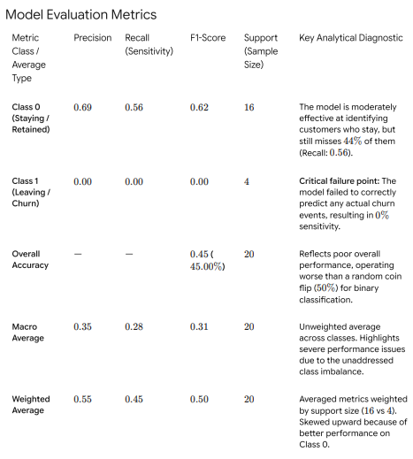
Dual-Model Evaluation Matrix

Slide 11
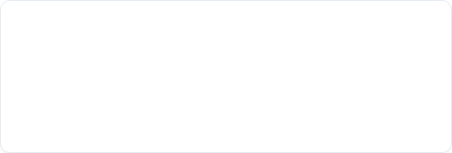
Proactive Retention Playbook
1. Contract Stabilization
2. Technical Feature Bundles
Address the Month-to-Month contract issue by identifying high-risk accounts and offering them exclusive discounts to transition to stable 1-Year or 2-Year plans.
Improve customer retention on expensive Fiber Optic accounts by bundling online security and tech support add-ons to increase service value and build digital loyalty.

Slide 12
Thank You

